Slide 1

CAR RESALE-VALUE PREDICTION
Presented by:
Keerthana Goka
Ashok Jangam
Vinay Konduru
Peiyu Sun

Slide 2

INTRODUCTION
With this project, we aim to show how linear regression may be used practically in the automobile sector, by estimating the worth of cars during resale, leading to more informed decisions.
By examining variables like brand, engine power, mileage, and year of production, a statistical technique called linear regression is useful for estimating automobile pricing.
This approach finds correlations between these attributes and automobile pricing by looking at past sales data. Both buyers and sellers may make more informed selections with the help of this prediction model.
Cars offered can be valued by buyers, and sellers can establish competition.

Slide 3
DATA EXPLORATION
Dependent variable:
Selling Price
Dataset Details:
Continuous Variables:
Categorical Variables:
Year
Brand
Source: Kaggle.com
Mileage
Fuel Type
Observations: 3998
Engine size
Seller
Variables: 11
Engine Power
Transmission
Fuel Type
Miles Driven
Owner type
No of Seats

Slide 4
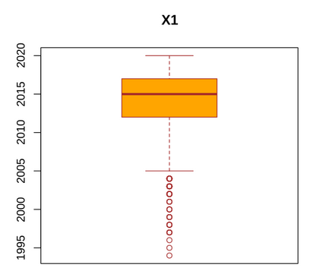
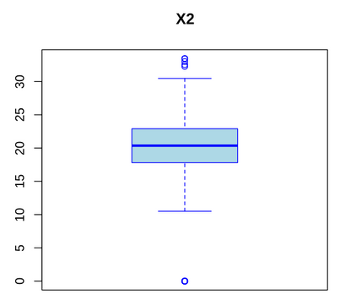
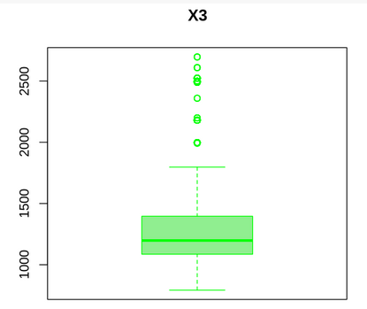
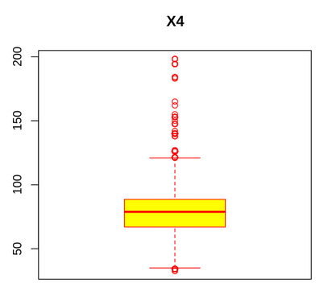
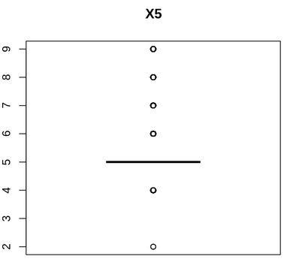
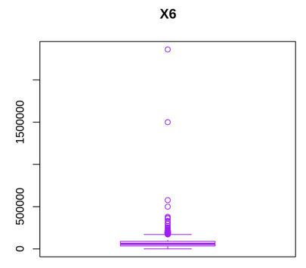
DATA EXPLORATION
Distribution and spread of data within a variables:

Slide 5
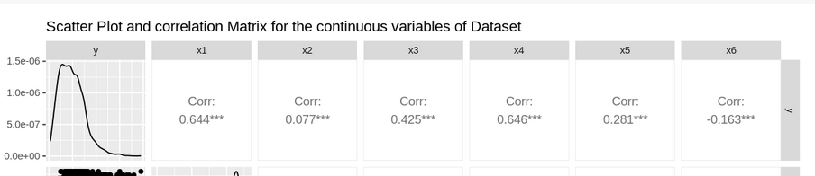
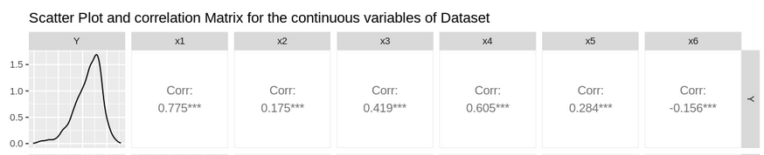
DEPENDENT VARIABLE (Y) TRANSFORMATION
Y has been transformed with log10 to increase the correlations:
After transformation:

Slide 6
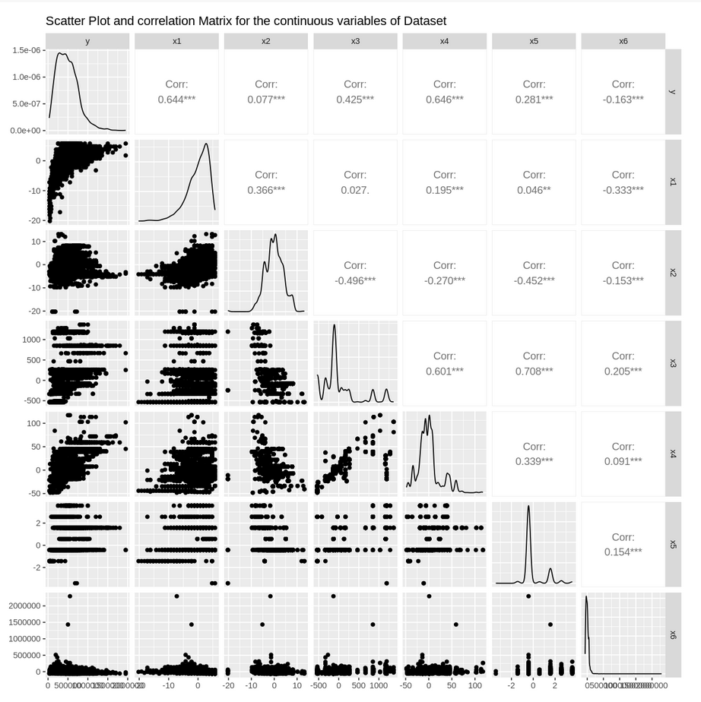
EXCLUDING VARIABLE
It is observed that Engine size is highly correlated with Max Power and Seats.
Hence Engine size was excluded from consideration in the model

Slide 7
EXPECTATION FROM THE MODEL:
Strong Correlation can be observed between Y and (x1,x4)
Year of purchase and
Max power of the engine
are the expected significant variables in the final model.

Slide 8
ADDING QUADRATIC AND INTERACTION TERMS
Total variables with single terms, quadratic terms and interaction terms: 91

Slide 9
DATA SPLITTING
80% of the sample size is selected for training and remaining 20% for testing the model.
Train set: 3198 observations
Test set: 800 observations
Mean Squared Prediction Error/MSE = 1.0201
As MSPR is 2% more than MSE, MSE is not biased and shows very good prediction ability of the train model.

Slide 10
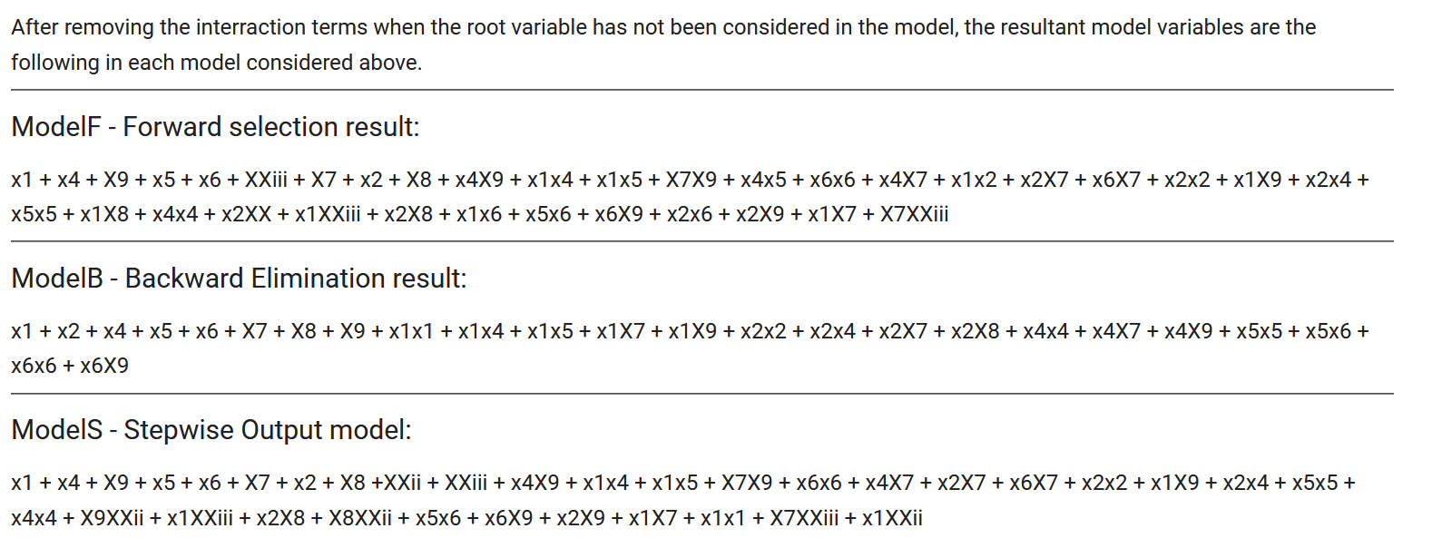
MODEL SELECTION
Model 1 using Forward Selection: ModelF
Model 2 using Backward Selection: ModelB
Model 3 using Stepwise Selection: ModelS
36 variables
25 variables
35 variables

Slide 11
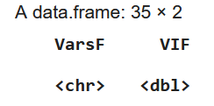
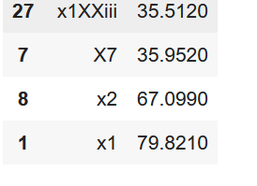
MULTICOLLINEARITY TEST
ModelF:
Highest VIF Values:
Without x1 : Multiple R-squared: 0.8985
Including x1: Multiple R-squared: 0.9021
It additionally is the variable with highest correlation with Y.
Hence x1 is not being removed from the model.

Slide 12
MODEL SELECTION USING Cp, BIC, R2 and Adj R2
Variables with highest R2 and Adj R2 values with lowest Cp and BIC values after removing the interaction terms without its root variables in the model:
ModelF:
'x1','x4','X9','x4X9','x1x4','x1x5',’x5’ (* 8 Variables selected)
ModelB:
'x1','x4','x5','X9','x1x4','x1x5','x4X9’ (* 8 Variables selected)
Same variables as ModelF. Hence not considering for further Model building
ModelS:
'x1','x4','X9','x1x4','x4X9’(* 5 Variables selected)

Slide 13
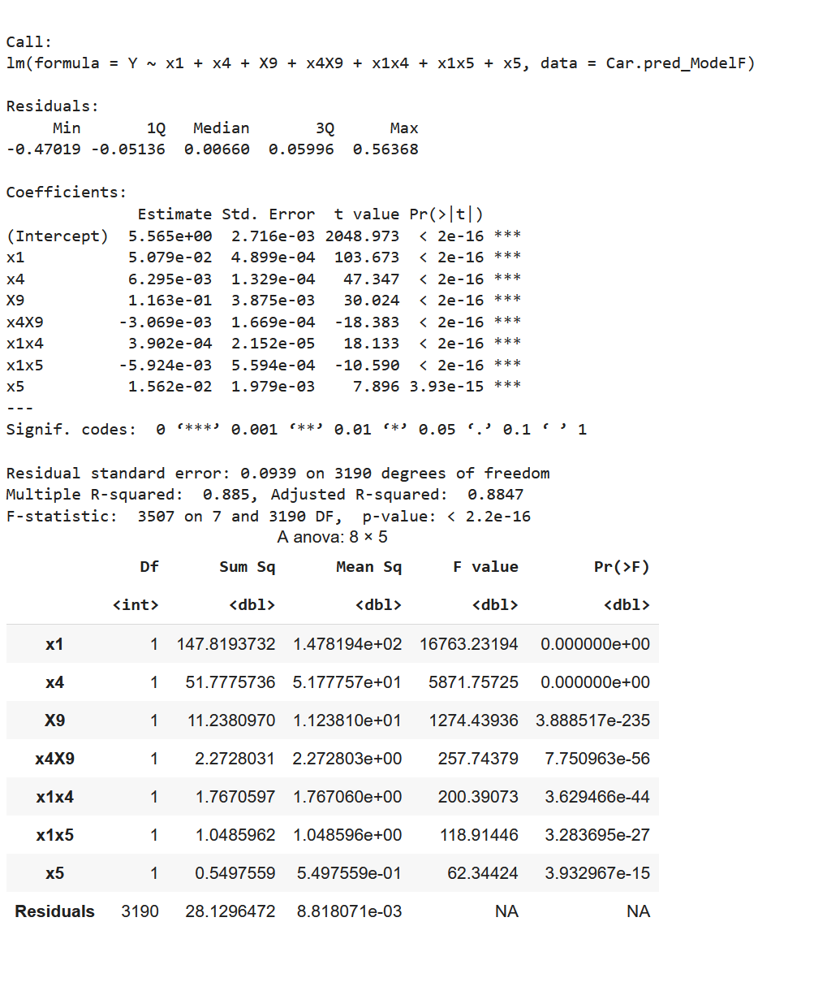
MODELF
Fitting ModelF using Multi-linear regression:
All variables show P-value close to ZERO, this indicates that all independent variables should be kept as per the model summary.
The R square value and adjusted Rsquare values are around 0.8 which shows that its a good fit.
High F Statistic also indicates not all Coefficients would be zero.

Slide 14
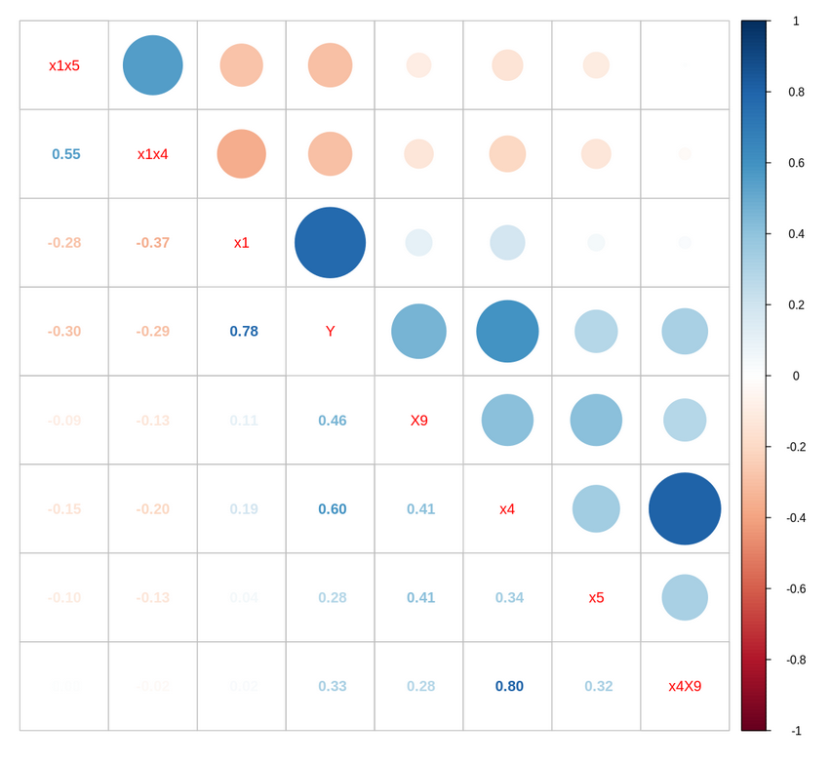
MODELF
Fitting ModelF using Multi-linear regression:
x1 is the highly correlated variable with Y.
x4 and x4X9 has highest correlation of 0.8.

Slide 15
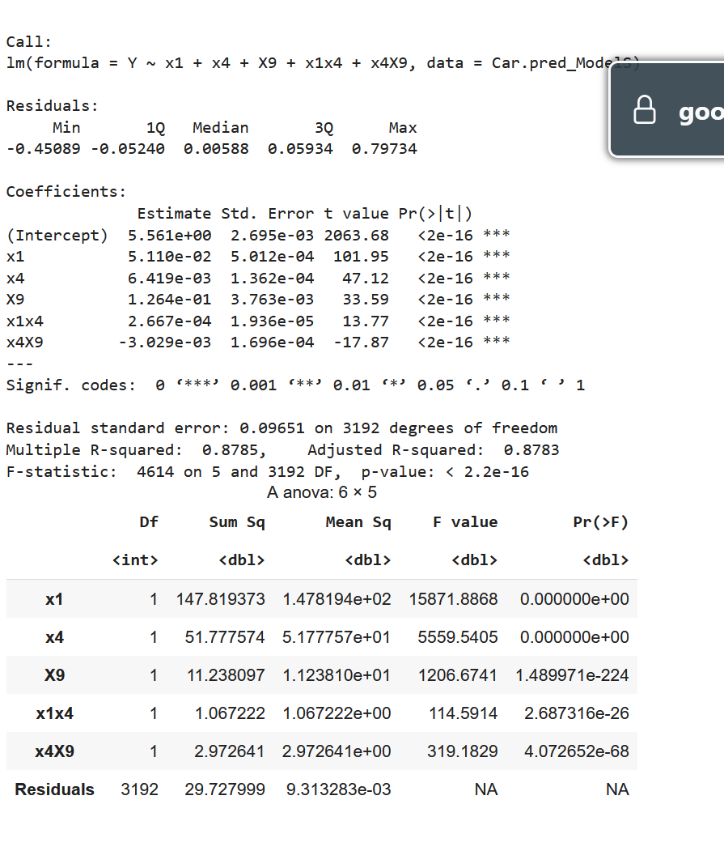
MODELS
Fitting ModelS using Multi-linear regression:
All five variables show P-value close to ZERO, this indicates that all independent variables should be kept.
The R square value and adjusted Rsquare values are around 0.878 which shows that its a very good fit.
High F Statistic also indicates not all Coefficients would be zero.

Slide 16
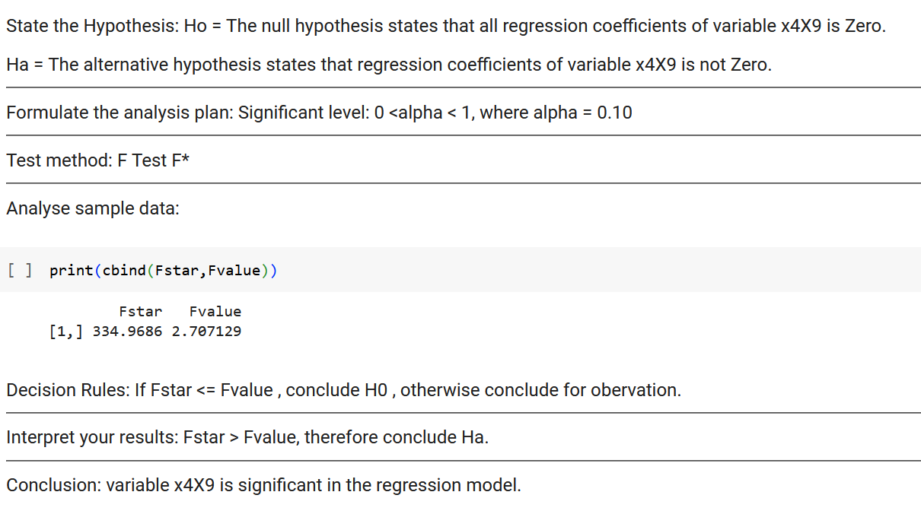
MODELF – EXTRA SUM OF SQUARES TEST
Variable selected: x4X9 which has high correlation with x4

Slide 17
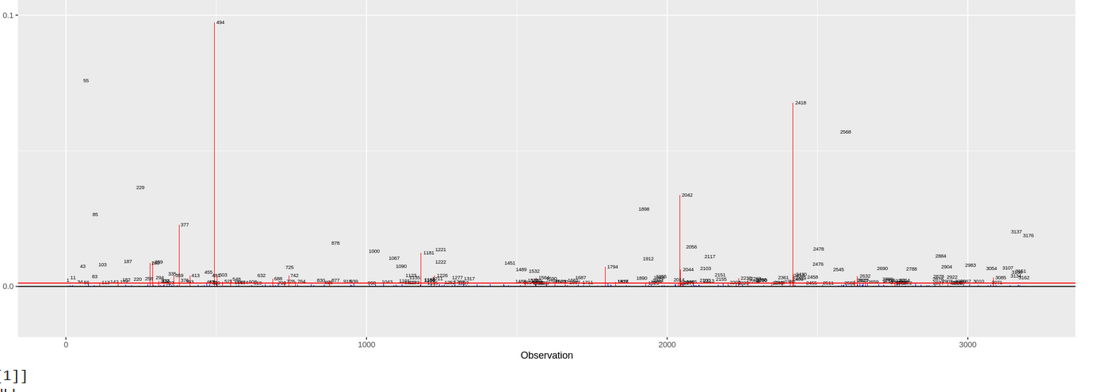
MODELF – OUTLIER AND INFLUENCIAL CASE ANALYSIS
OUTLIERS IN Y: Using Deleted Studentized Residuals:
The deleted studentized residual difference shows that cases 1181, 2448, 1898, 187, 229, 1000, 878 are outlying Y observation (outlier).
OUTLIERS IN X: Using Leverage:
326 cases have been observed to be outliers using leverage measure.
Using DFBETAS, 339 influencial cases have been identified.

Slide 18
MODELF – OUTLIER AND INFLUENCIAL CASE ANALYSIS
As per the values of DFBetas, 339 infuencial cases have been indentified in the model. Additionally, 326 outliers in X have been identified.
Of the two list, 24 observations have been identified to be present in both.They are:
561,352,494,507,908,972,998,1056,1482,1590,1827,1952,2014,2356,2420,2720,2806,2860,2889,2907,2924,2926,2979,3059
Further 1181 is an outliers in Y identified which is also influencial.
Hence these 25 observations are outliers which are influencial. As these are affecting the fit of the model, we delete the 25 observations from the model.

Slide 19
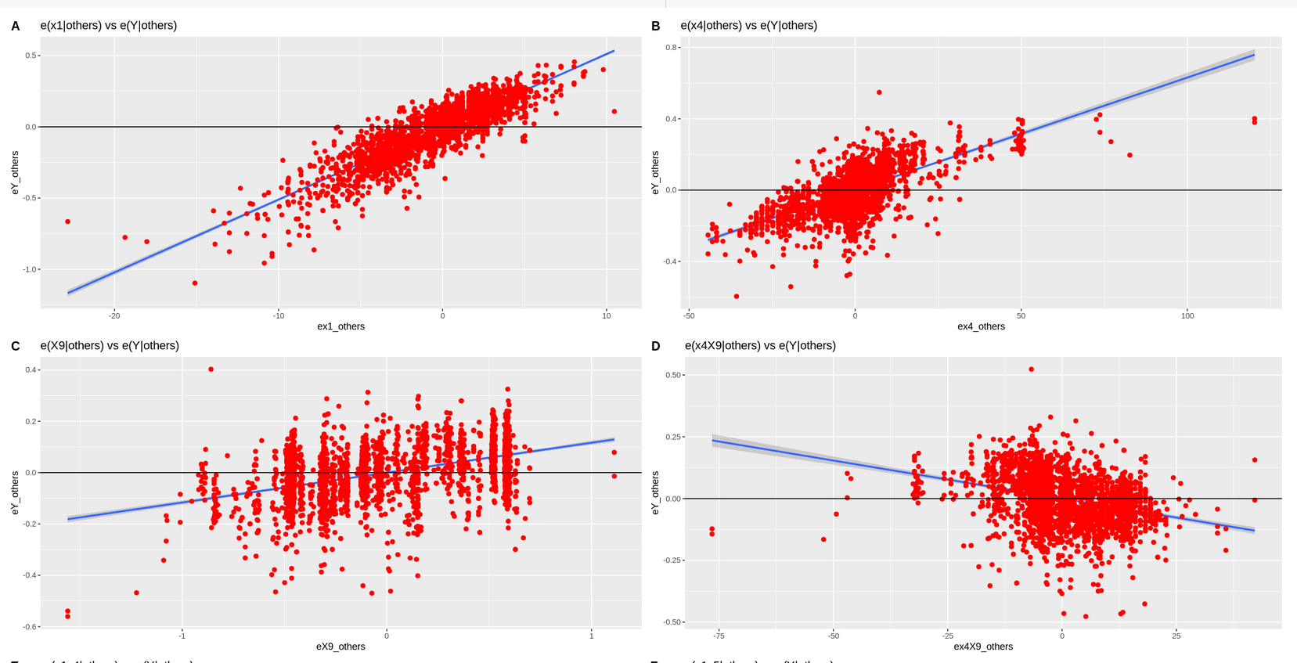
MODELF – ADDED VARIABLE PLOTS

Slide 20
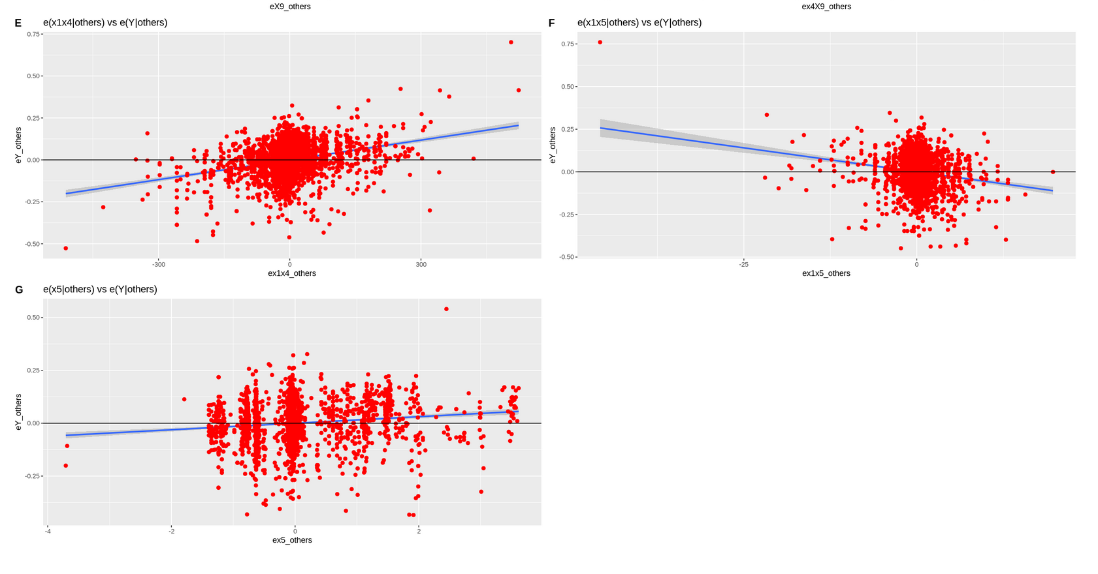
MODELF – ADDED VARIABLE PLOTS
From the Added Variable Plots above, shows the importance of all the X variables in defining the variance in response variable Y.
So, the regression relationships in the fitted regression function are appropriate

Slide 21
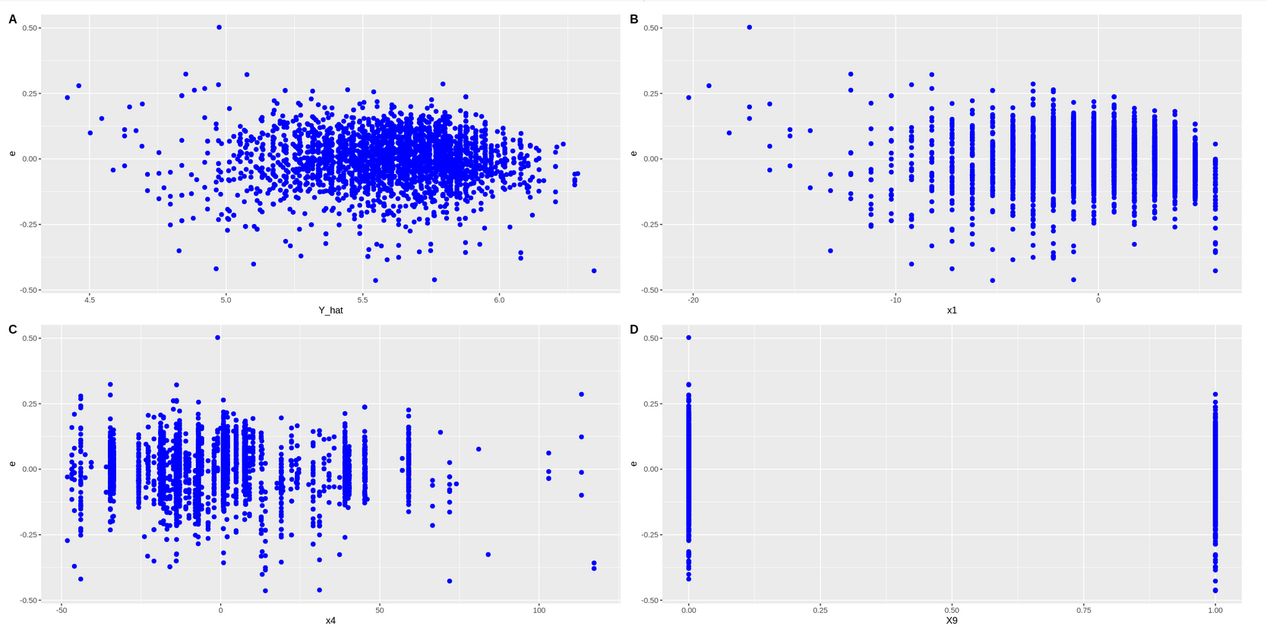
MODELF – RESIDUAL ANALYSIS

Slide 22
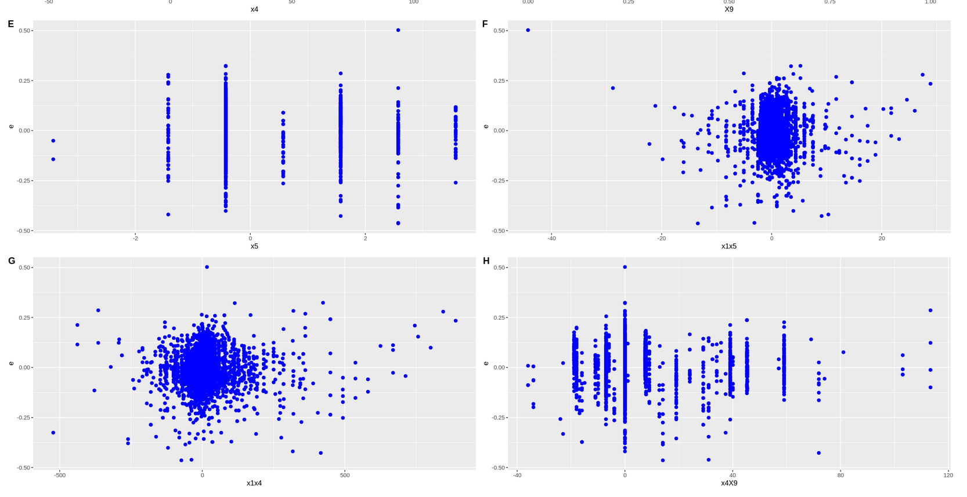
MODELF – RESIDUAL ANALYSIS

Slide 23
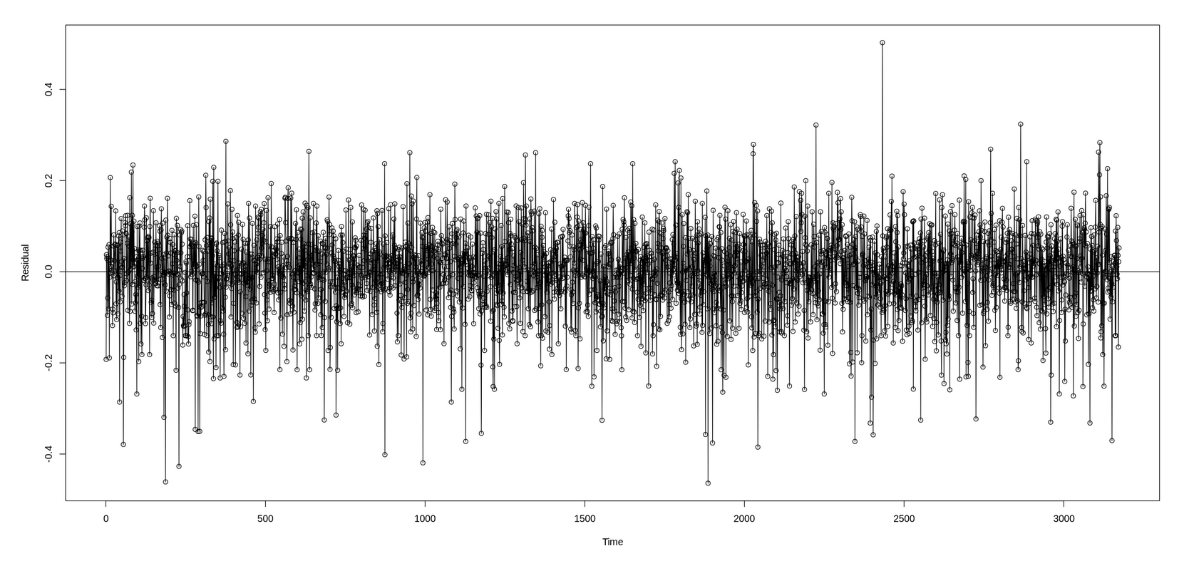
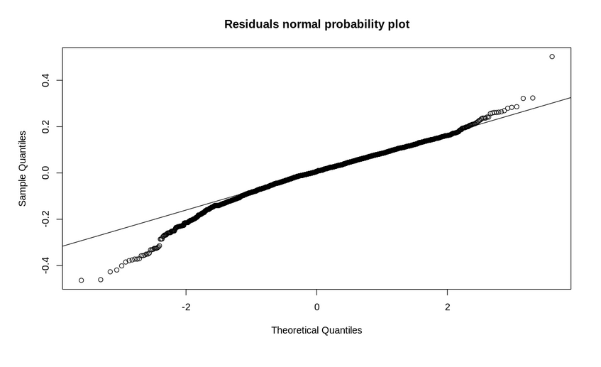
MODELF – RESIDUAL ANALYSIS

Slide 24
MODELF – RESIDUAL ANALYSIS
Linearity assumption and Homoscedasticity assumption: plots show linearity and Homoscedasticity of residuals
Normality assumption: Quantile-Quantile (QQ) plot, shows that there exists tail in both sides of normal distribution of residuals. Tail is prominent hence requires more tests to confirm.
Outliers assumption: plots show no sign of outliers.
Independence Assumption plots show independence of residuals

Slide 25
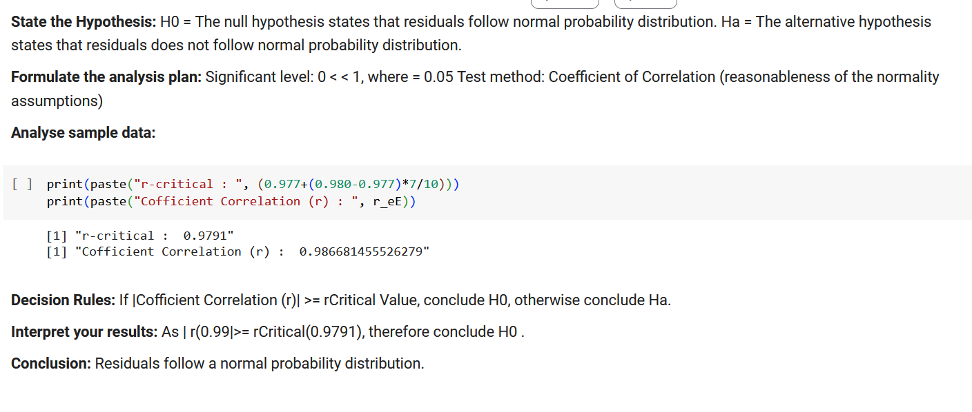
MODELF – RESIDUAL ANALYSIS – DIAGNOSTIC TESTS
Correlation Normality Test

Slide 26
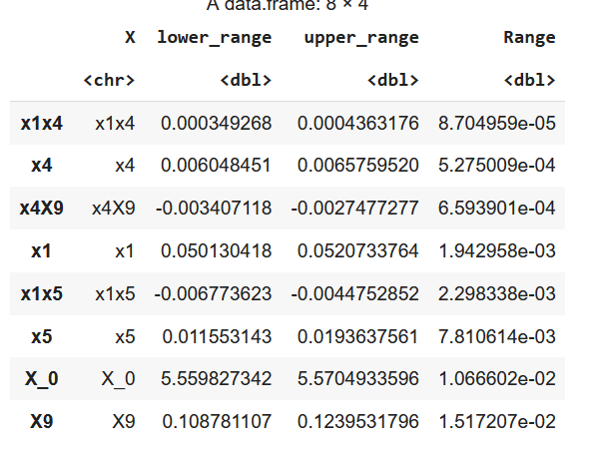
MODELF – INFERENCE IN REGRESSION ANALYSIS
Confidence Interval for Beta k of MLR ModelF
The confidence Intervals of Betas are calculated above. x1x4 has the tightest interval and X9 has a wider confidence interval. Neverthless, as the range is less than 0.01 it is expected to be good enough.

Slide 27
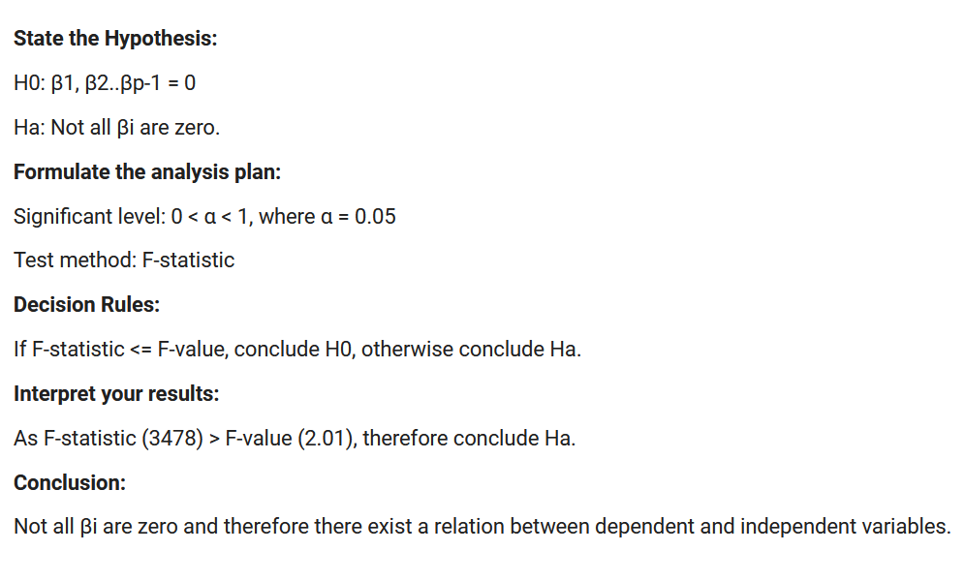
MODELF – HYPOTHESIS ANALYSIS
F-Test (ANOVA)For MLR

Slide 28
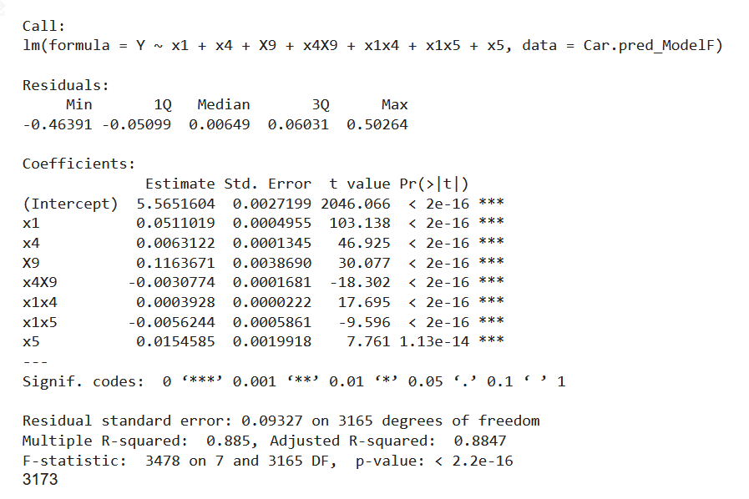
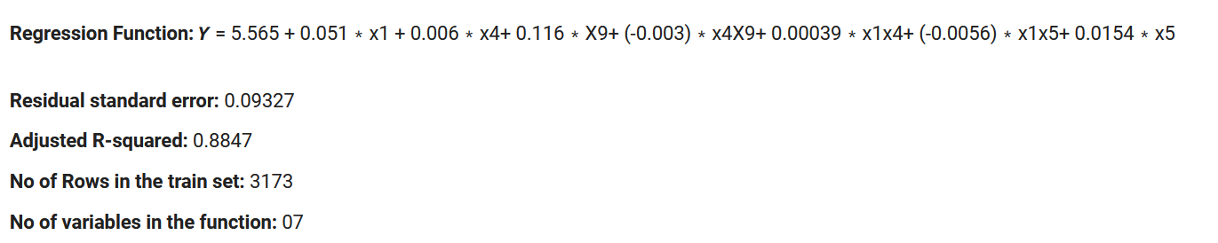
FINAL MLR MODELF
Summary:

Slide 29
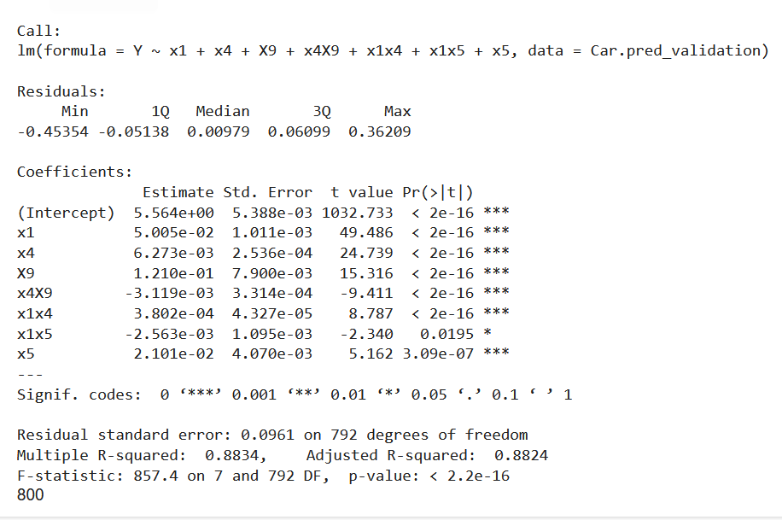
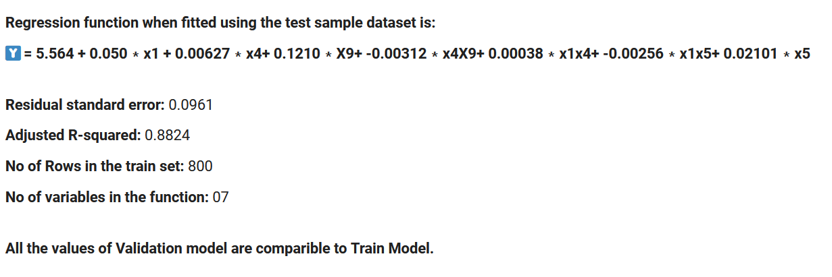
MODEL VALIDATION OF MODELF
Summary:

Slide 30
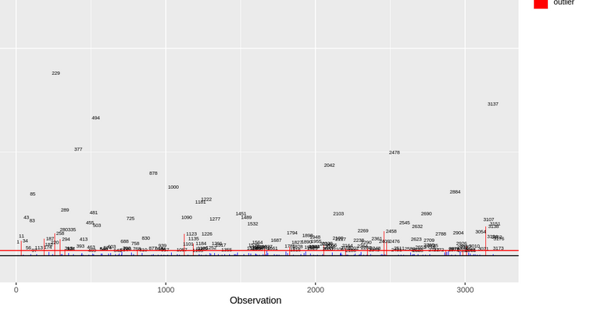
MODELS – OUTLIER AND INFLUENCIAL CASE ANALYSIS
OUTLIERS IN Y: Using Deleted Studentized Residuals:
The deleted studentized residual difference shows 10 cases that are outlying Y observation (outlier).
OUTLIERS IN X: Using Leverage:
282 cases have been observed to be outliers using leverage measure.
Using DFBETAS, 339 influencial cases have been identified.

Slide 31
MODELS – OUTLIER AND INFLUENCIAL CASE ANALYSIS
As per the values of DFBetas, 339 infuencial cases have been indentified in the model. Additionally,282 outliers in X have been identified.
Further there are 10 outliers in Y identified which are also influencial.
Of the lists, 28 observations have been identified to be present in both.
They are: 352, 494, 507, 561, 874, 908, 998, 1056, 1181, 1482, 1590, 1827, 1948, 1952, 2014, 2288, 2356, 2420, 2720, 2791, 2806, 2889, 2907, 2924, 2926, 3059, 3107, 3162
Hence these 28 observations are outliers which are influencial. As these are affecting the fit of the model, we delete the 28 observations from the model.

Slide 32
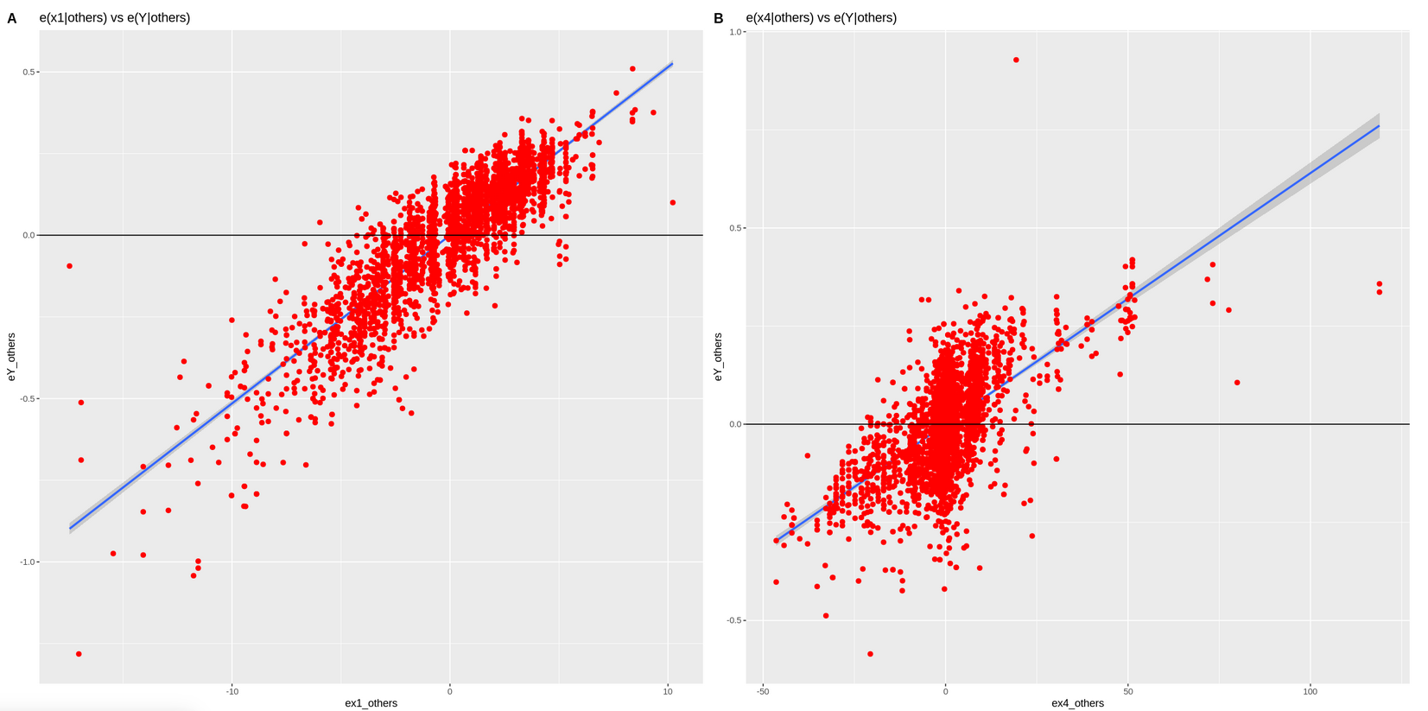
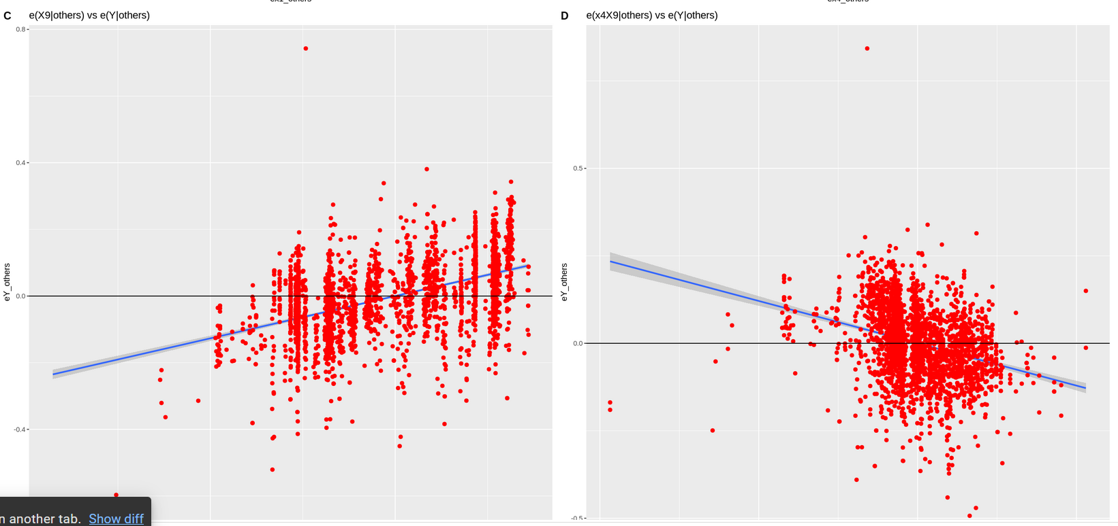
MODELS – ADDED VARIABLE PLOTS

Slide 33
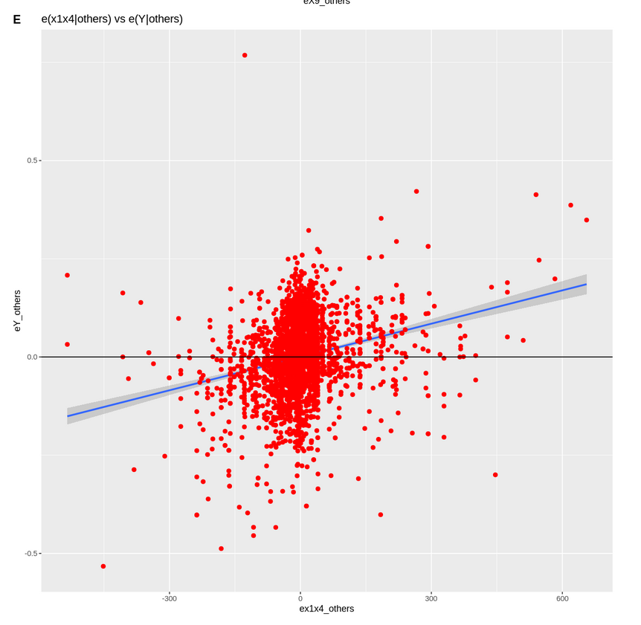
MODELS – ADDED VARIABLE PLOTS
From the Added Variable Plots above, shows the importance of all the X variables in defining the variance in response variable Y.
So, the regression relationships in the fitted regression function are appropriate

Slide 34
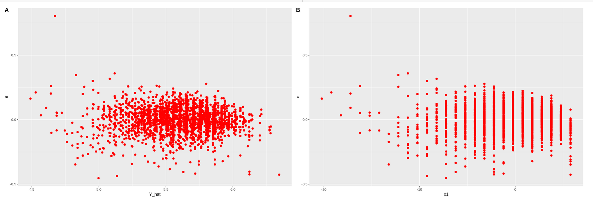
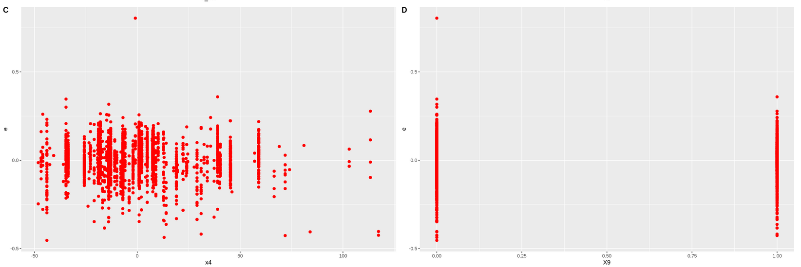
MODELS – RESIDUAL ANALYSIS

Slide 35
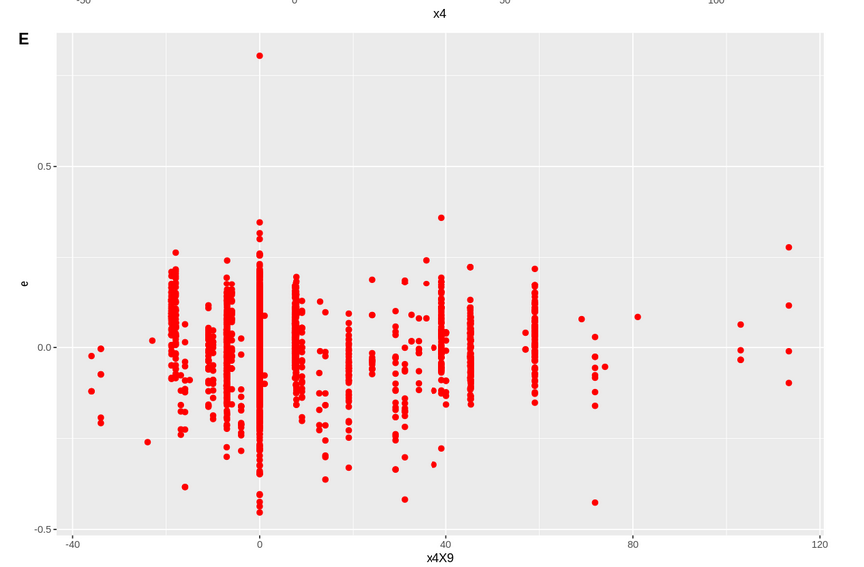
MODELS – RESIDUAL ANALYSIS

Slide 36
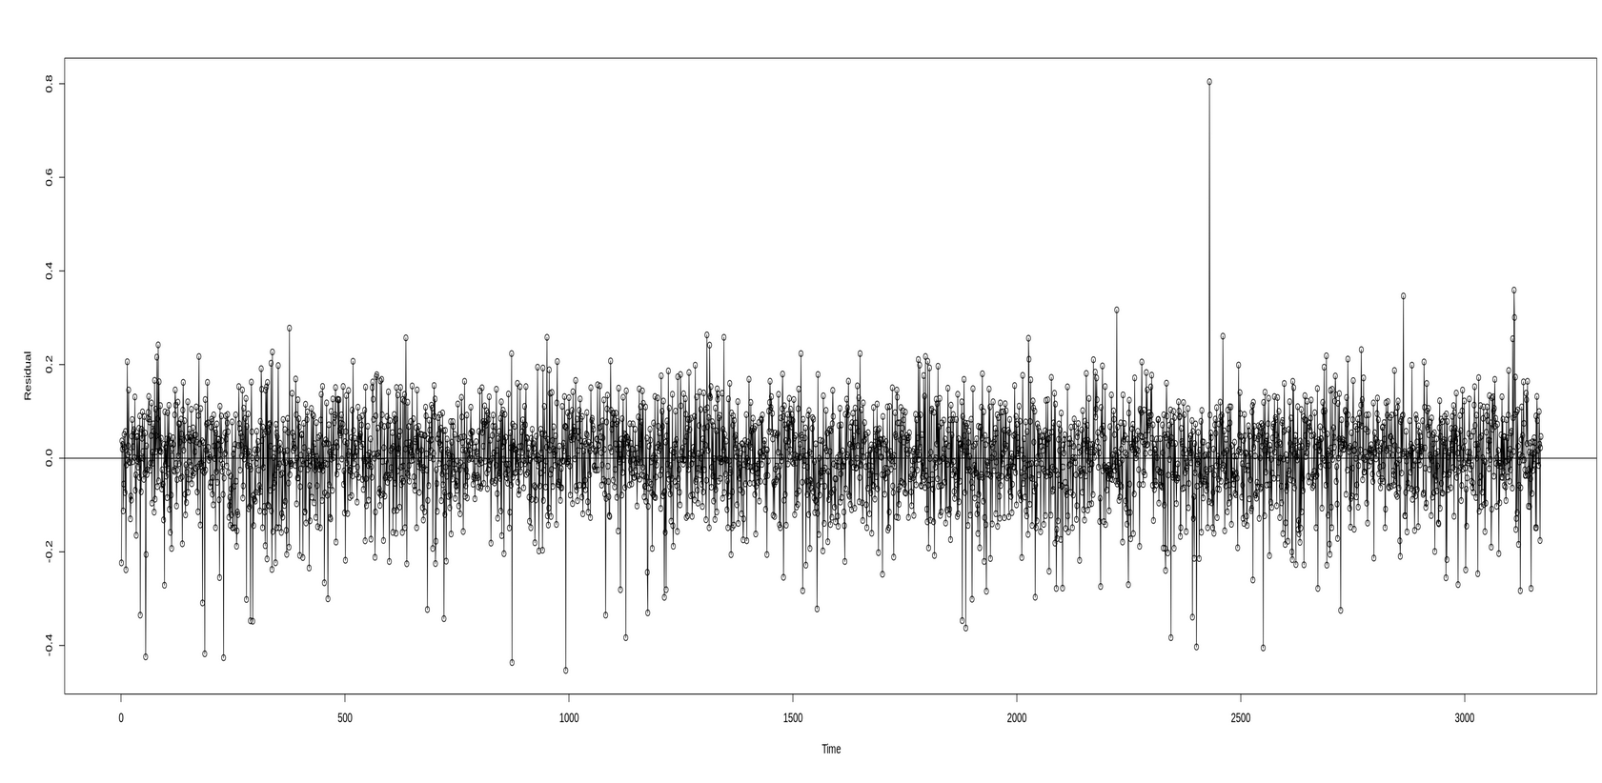
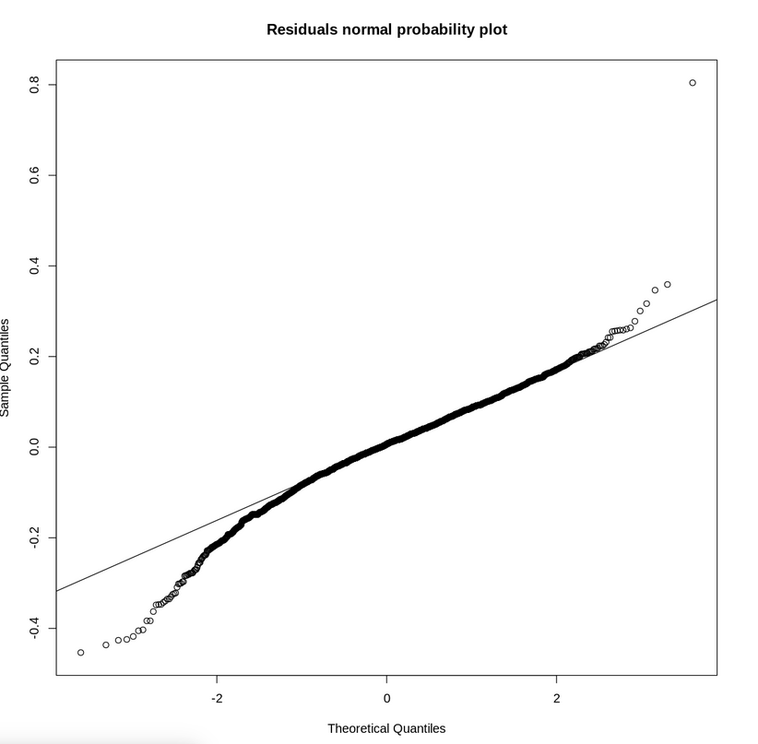
MODELS – RESIDUAL ANALYSIS

Slide 37
MODELS – RESIDUAL ANALYSIS
Linearity assumption and Homoscedasticity assumption: plots show linearity and Homoscedasticity of residuals
Normality assumption: Quantile-Quantile (QQ) plot, shows that there exists tail in both sides of normal distribution of residuals. Tail is prominent hence requires more tests to confirm.
Outliers assumption: plots show no sign of outliers.
Independence Assumption plots show independence of residuals

Slide 38
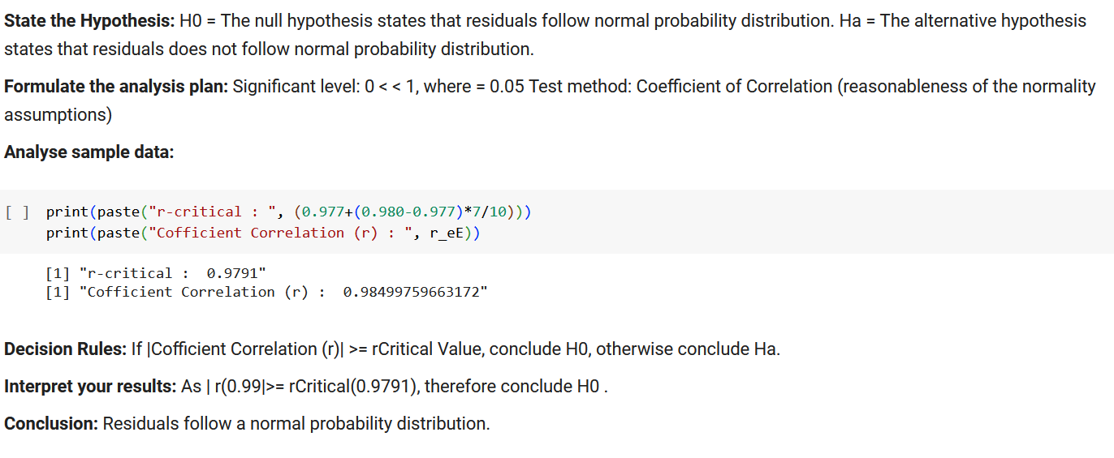
MODELS – RESIDUAL ANALYSIS – DIAGNOSTIC TESTS
Correlation Normality Test

Slide 39
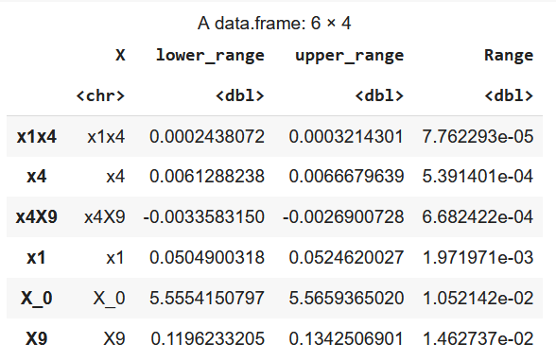
MODELS – INFERENCE IN REGRESSION ANALYSIS
Confidence Interval for Beta k of MLR ModelF
The confidence Intervals of Betas are calculated above.
x1x4 has the tighest interval and X9 has a wider confidence interval. Neverthless, as the ranges are less than 0.02 it is expected to be good enough.

Slide 40
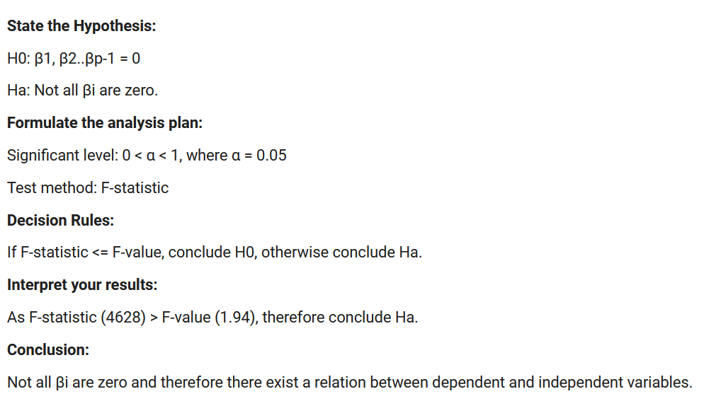
MODELS – HYPOTHESIS ANALYSIS
F-Test (ANOVA)For MLR

Slide 41
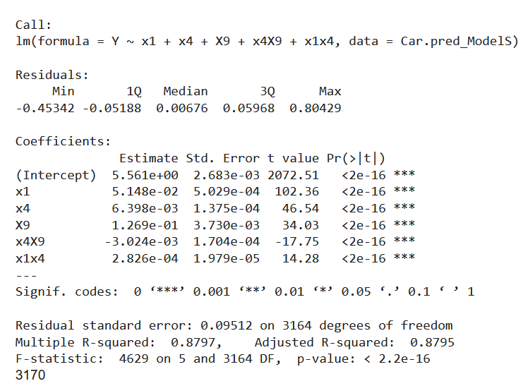
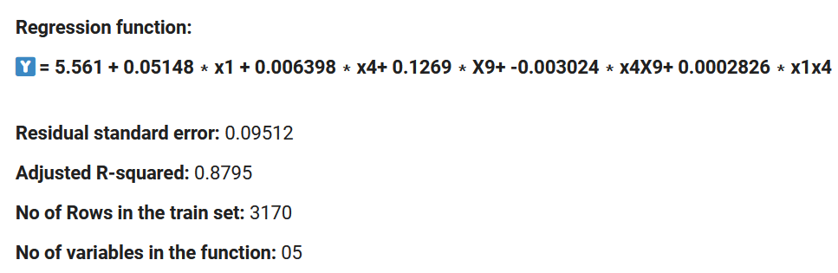
FINAL MLR MODELS
Summary:

Slide 42
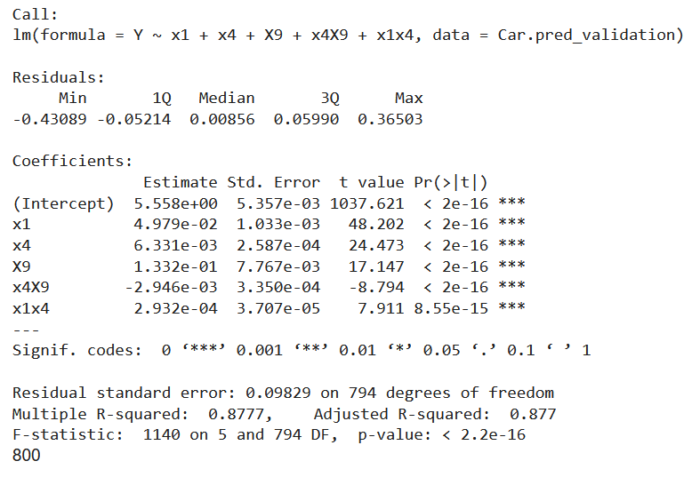
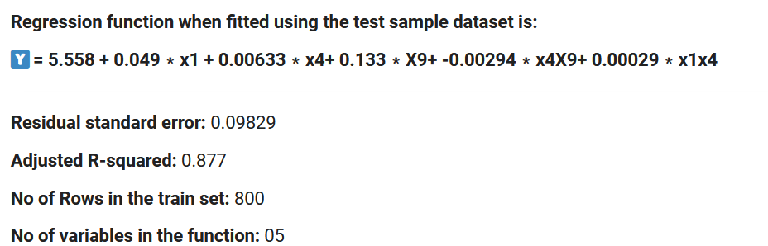
MODEL VALIDATION OF MODELS
Summary:

Slide 43
CONCLUSION
The Adjusted R-squared value of ModelF is
Adjusted R-squared of ModelF: 0.882
Adjusted R-squared of ModelS: 0.877
As both the models have almost same R-squared values, the 5 variable model is considered which is ModelS rather than 7 variable model which is ModelF
Suggested Model: ModelS

Slide 44
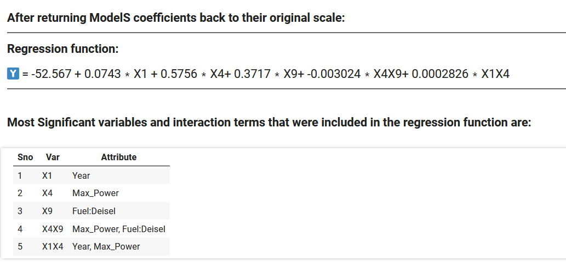
CONCLUSION

Slide 45
THANK YOU

